Slide 1
Taxi Fare Analysis Exploring Influences of Location, Time, and Conditions

Slide 2
Our team
Ahmed Masood
Ahmed Antar
Youssef Mohammed
Raneem Bakkar
Hesham Omar
Amr Akl
Ali Taha
Sondos

Slide 3
Table of contents
01
02
03
04
05
Introduction
Data Cleaning
Data Analysis
Conclusion
Outro

Slide 4
01
Introduction
How the story begin?!

Slide 5
Introduction
Welcome to our exploration of taxi
fare dynamics. Using a rich dataset
that includes passenger and driver
details, weather conditions, traffic
states, and geographical data, we’ll
uncover key insights into how fares
are determined. Our analysis aims to
reveal hidden patterns and factors
influencing pricing.
In this presentation, we’ll translate these insights into actionable recommendations to optimize fare structures and enhance the customer experience. Join us as we turn complex data into valuable narratives and practical strategies for improving the taxi industry.

Slide 6
General Numbers

Slide 7
500,000
221,675
221,700
Our Dataset
Users
Drivers

Slide 8
Our Goal

Slide 9
02
Data Cleaning
Investigate, Evaluate, Enhance

Slide 10
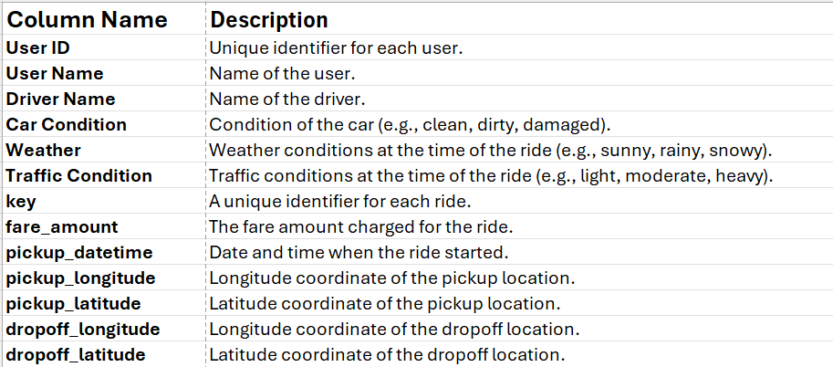
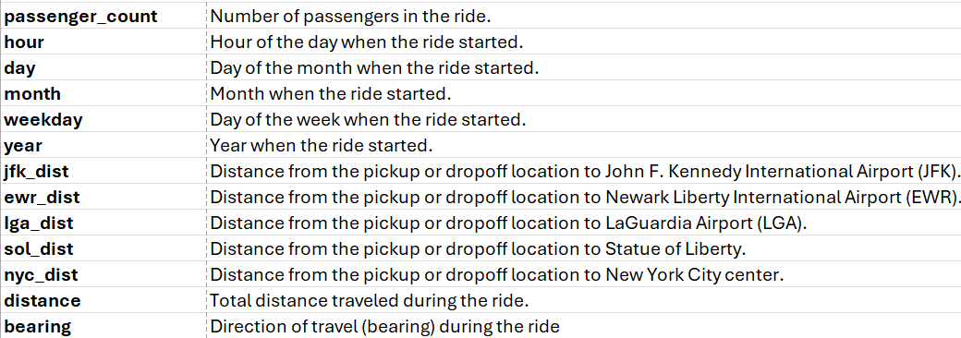
Data Features

Slide 11
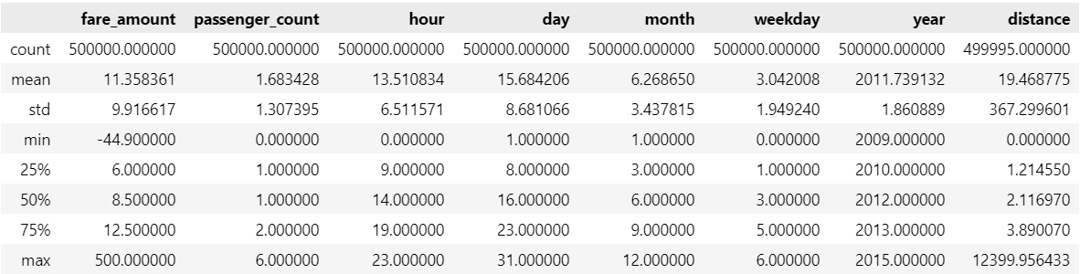
Statistics of Taxi Fare Dataset

Slide 12
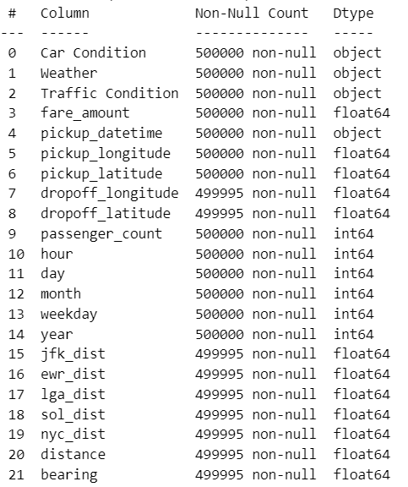
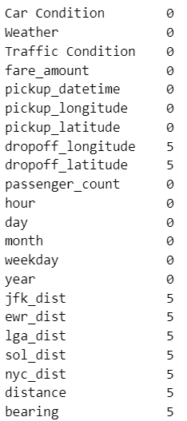
Data Info
Missing Values

Slide 13
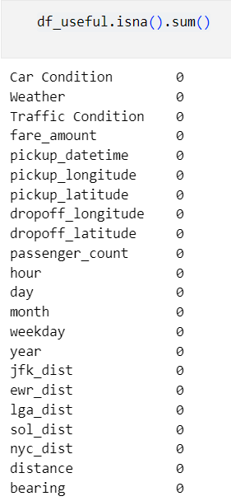
Handling Missing Values
Since there are only five null values in the dataset, we can safely remove them without impacting our analysis.

Slide 14
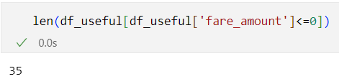
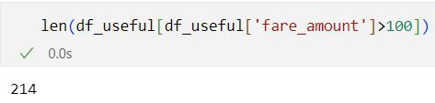
Data Quality Issues
1. Fare Amount :
The ‘fare_amount’ column includes negative values, with a minimum of −44.90. This is not feasible for real-world taxi fares and indicates potential data entry errors or invalid transactions
2. Unusually High Fare Amounts :
The maximum fare amount is 500, which could represent legitimate long-distance trips or high-demand periods, but might also indicate outliers that need further investigation.

Slide 15
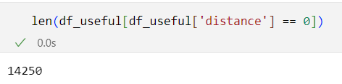
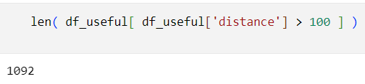
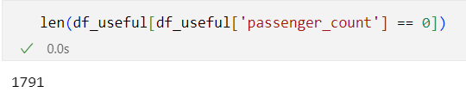
Data Quality Issues
3. Zero and Unreasonably High Distances :
The ‘distance‘ column includes zero values, which may suggest trips that were canceled, incorrectly logged, or very short. Additionally, the maximum distance of 12,399 km. suggests potential data entry errors or outliers that are not representative of typical taxi trips.
4. Passenger Count Discrepancies :
The ‘passenger_count’ column ranges from 0 to 6, with zero passengers being an obvious anomaly, as every taxi trip should have at least one passenger.

Slide 16
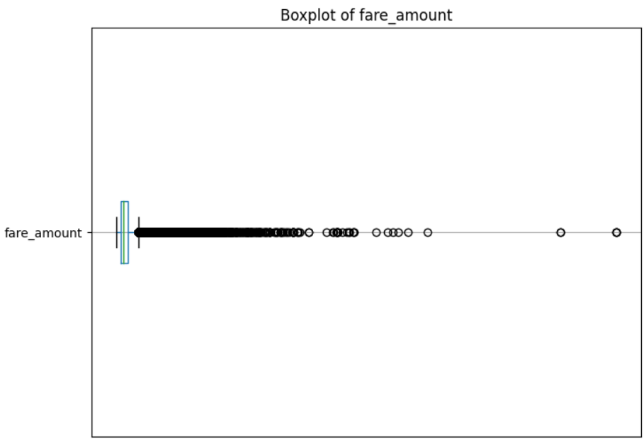
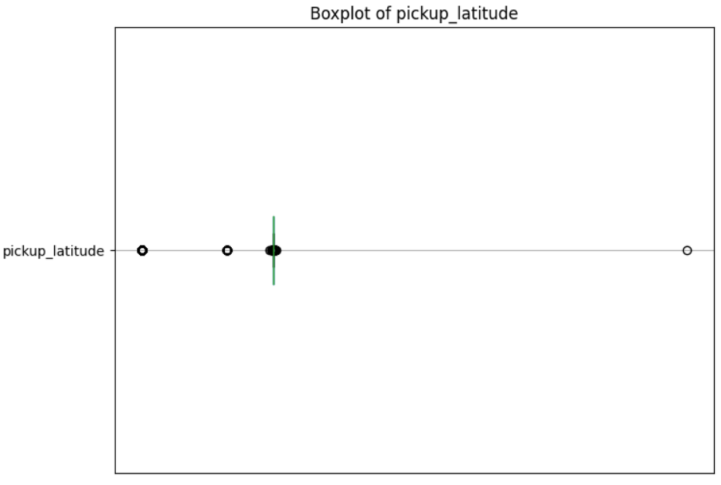
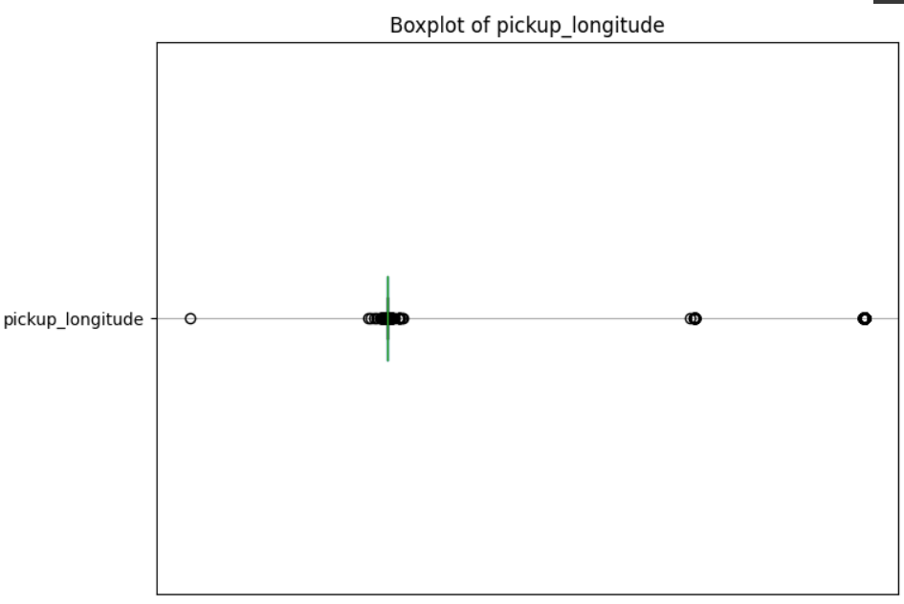
Outliers Visualization
fare_amount
Pickup_latitude
Pickup_longitude

Slide 17
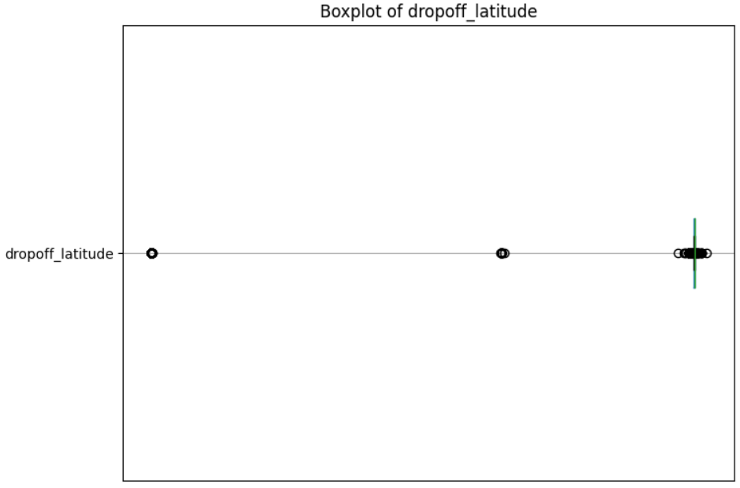
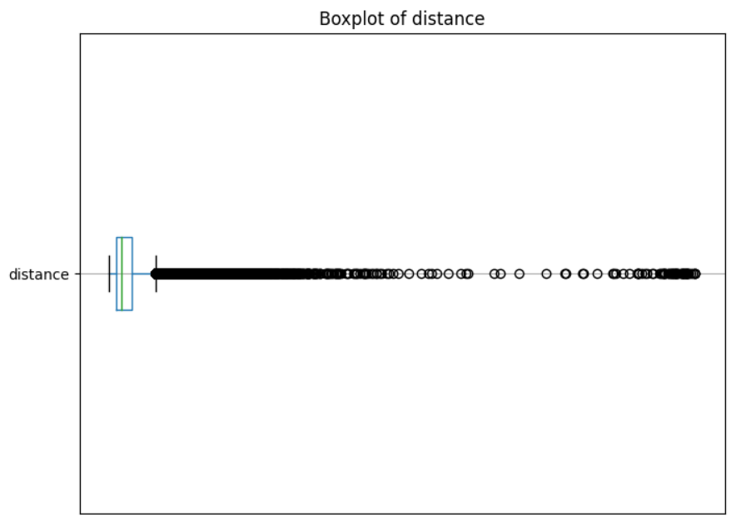
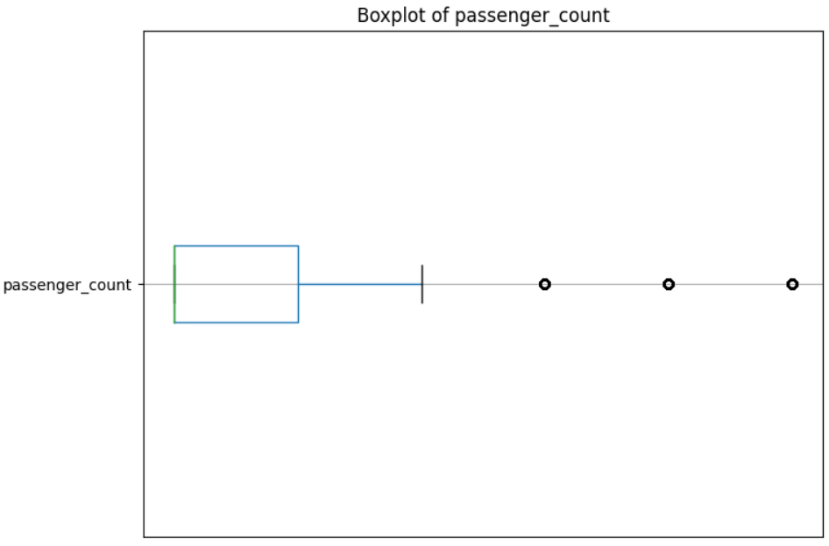
Outliers Visualization
Dropoff_latitude
distance
Passenger_count

Slide 18
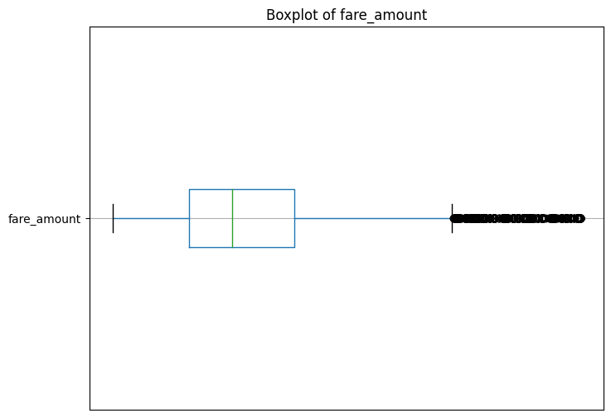
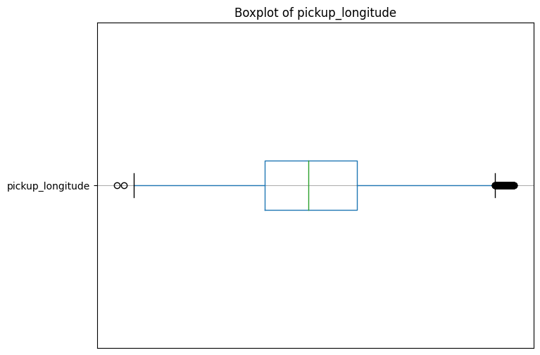
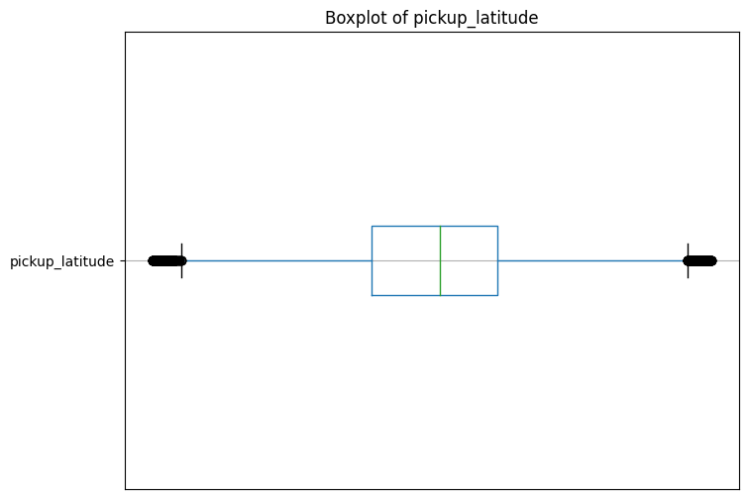
Post-Outliers Handling
fare_amount
Pickup_latitude
Pickup_longitude

Slide 19
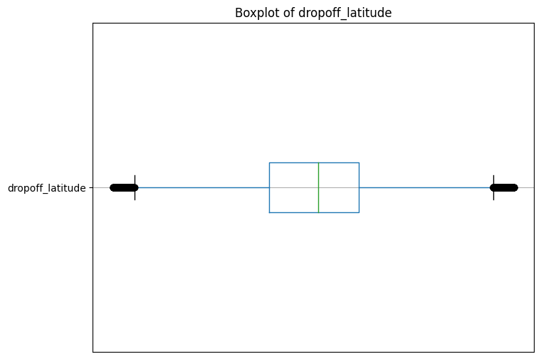
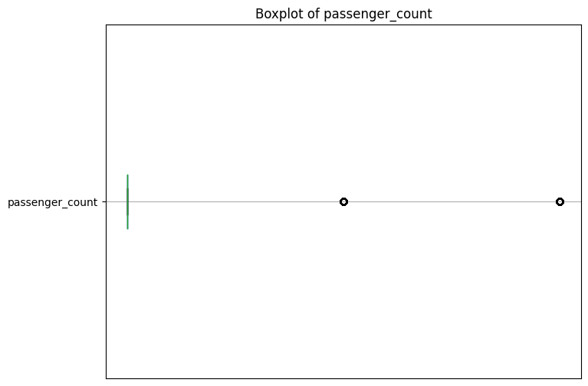
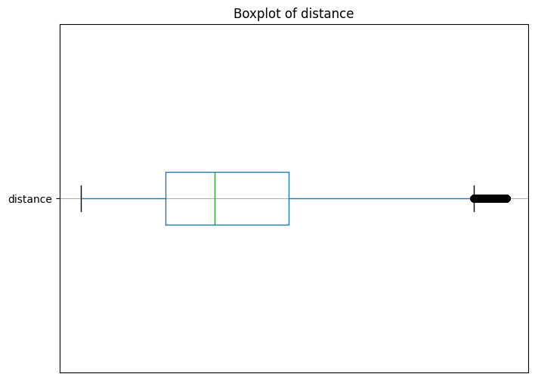
Post-Outliers Handling
Dropoff_latitude
distance
Passenger_count

Slide 20
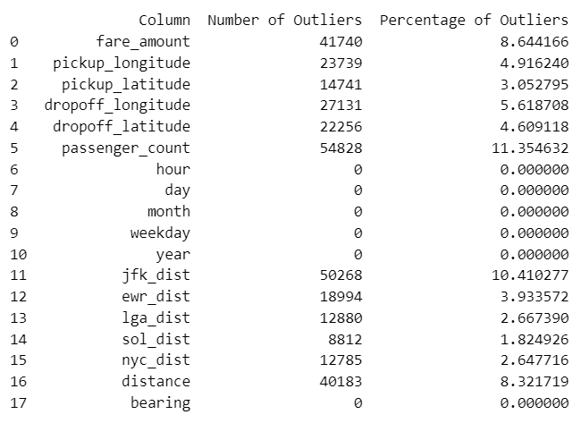
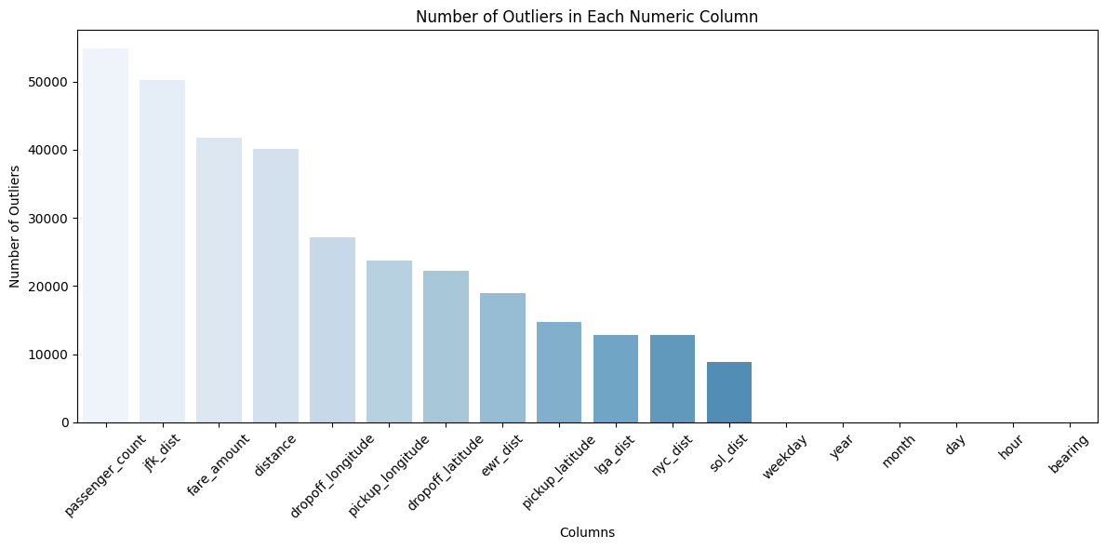
Outlier Percentages

Slide 21
03
Data Analysis
Understand, Analyze, Explain

Slide 22
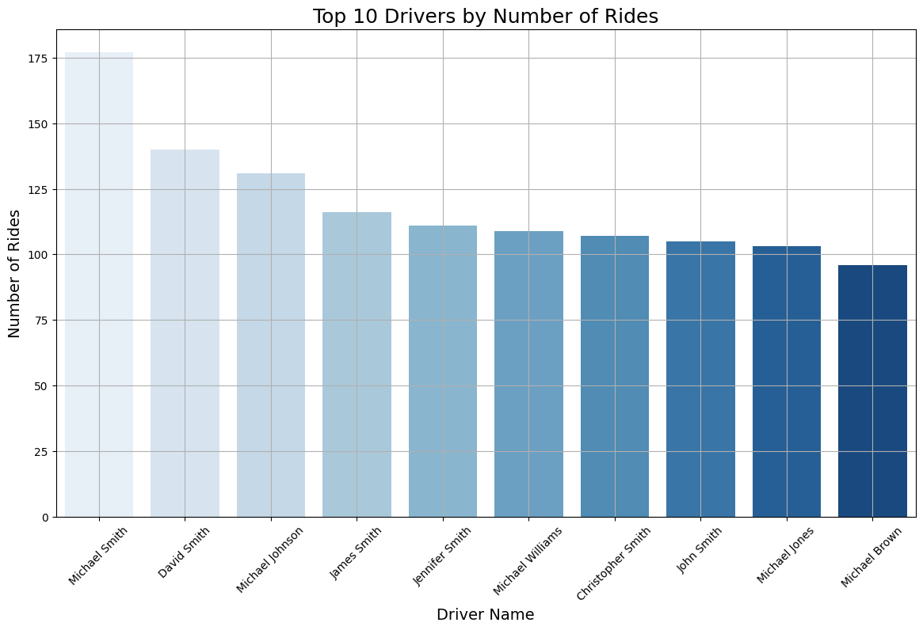
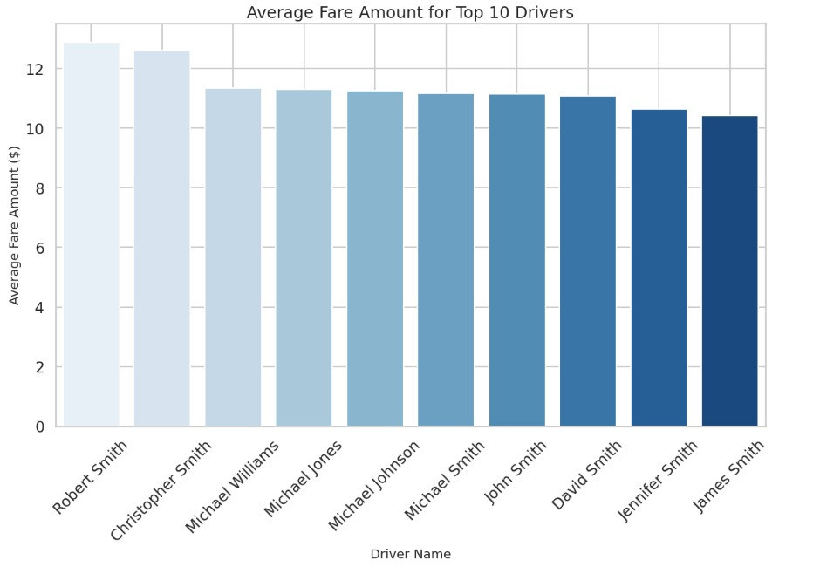
Drivers Performance

Slide 23
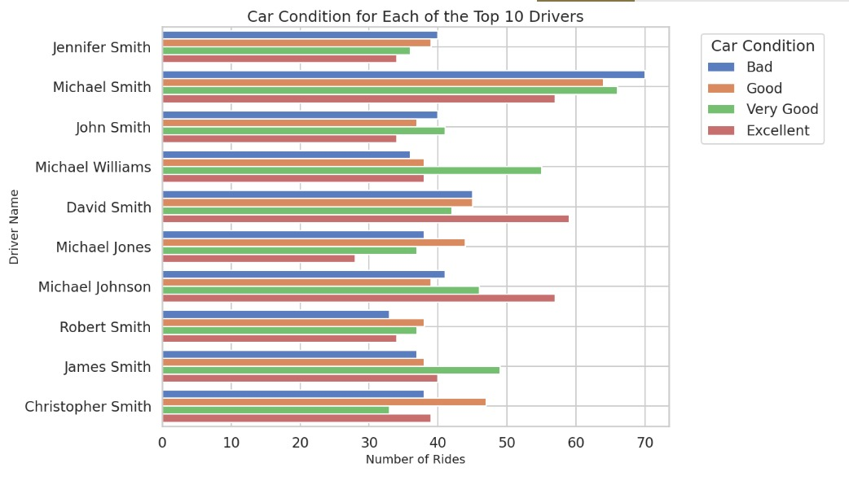
Car Conditions

Slide 24
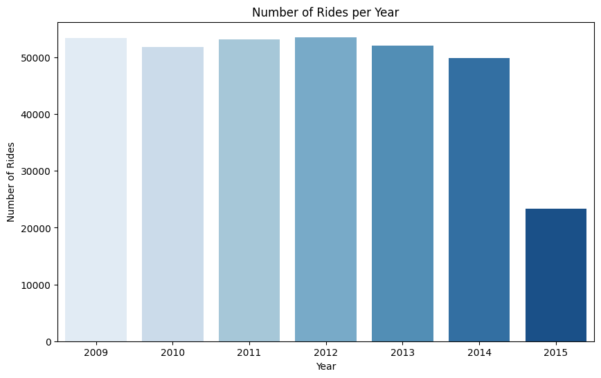
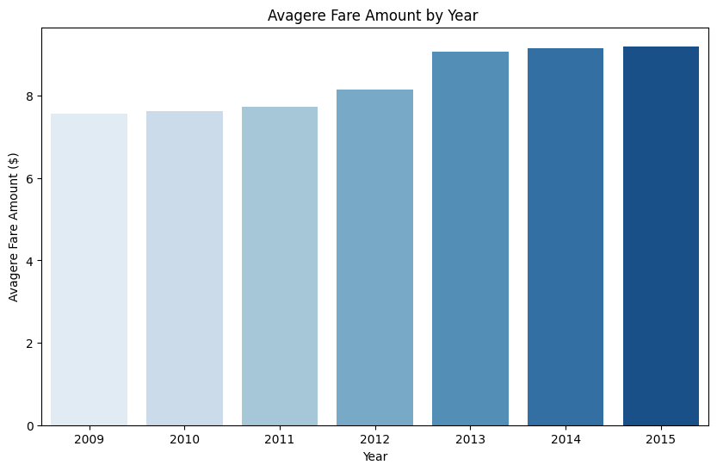
Difference in Years

Slide 25
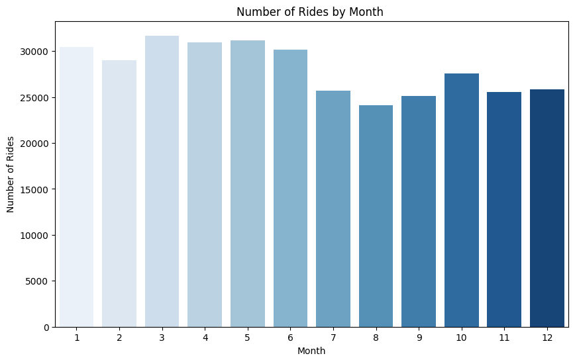
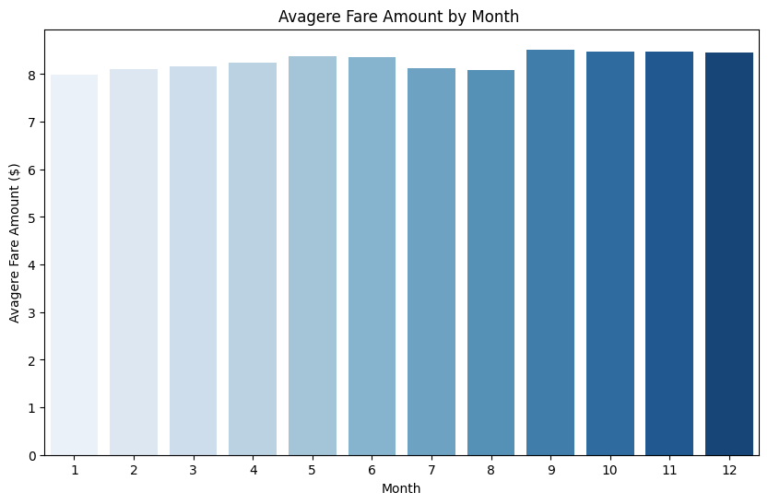
Difference in Months

Slide 26
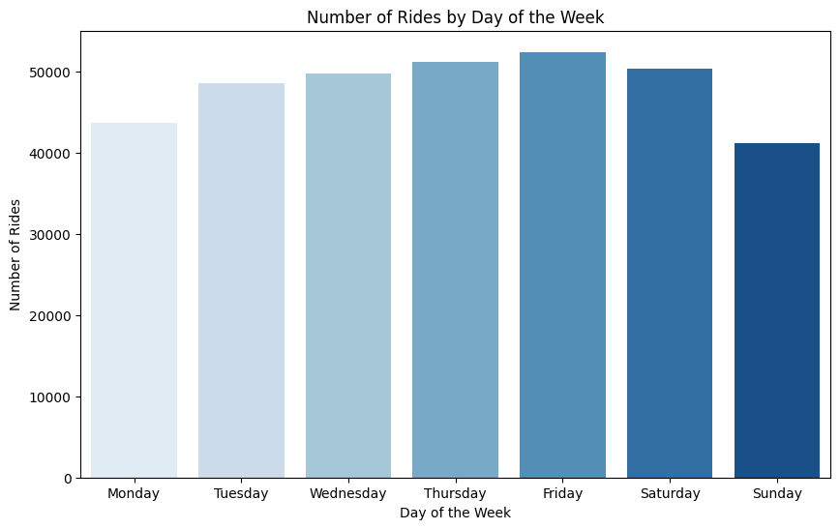
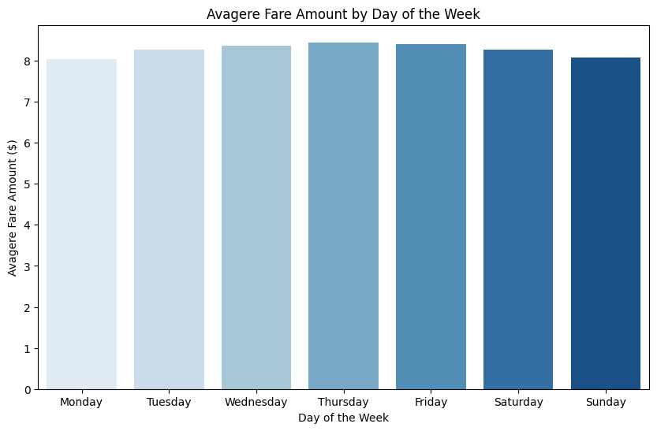
Difference in Days of Week

Slide 27
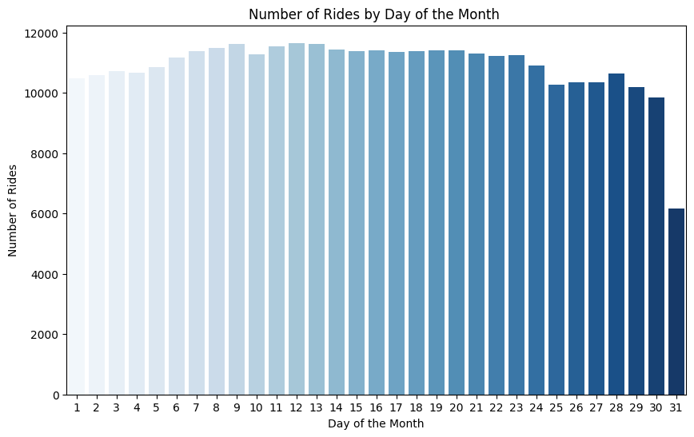
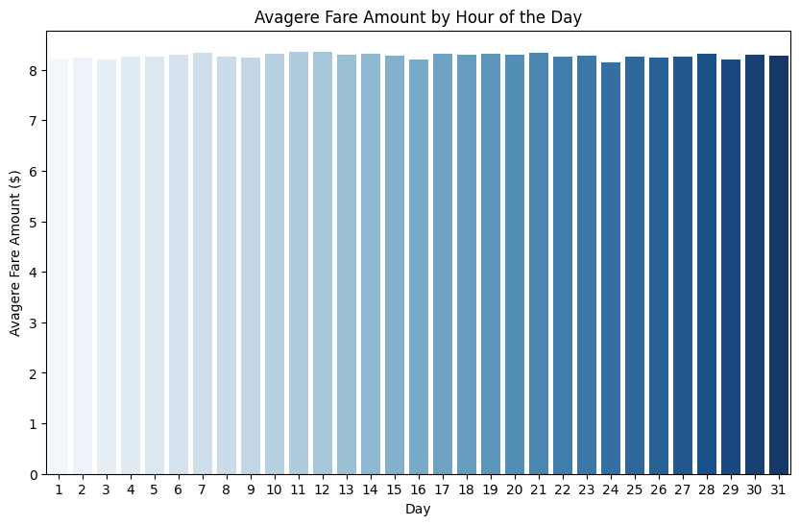
Difference in Days of Month

Slide 28
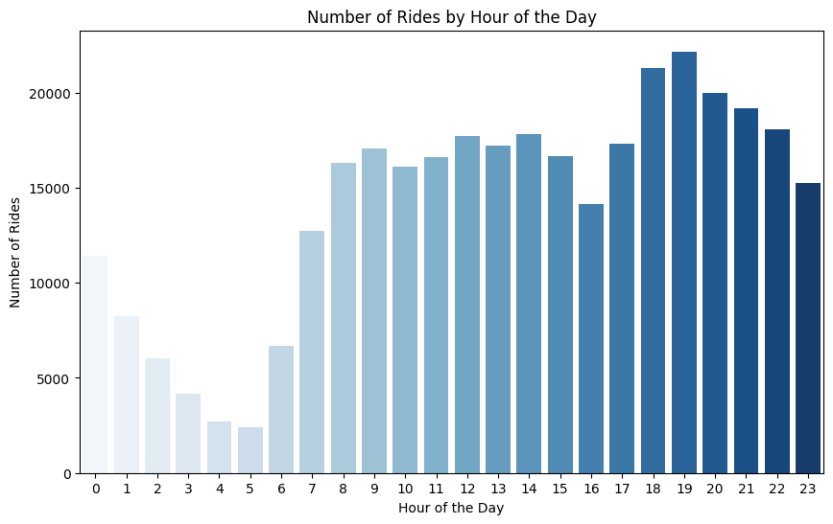
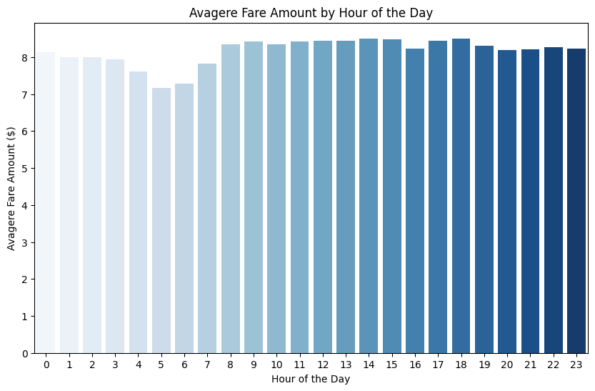
Difference in Hours of The Day

Slide 29
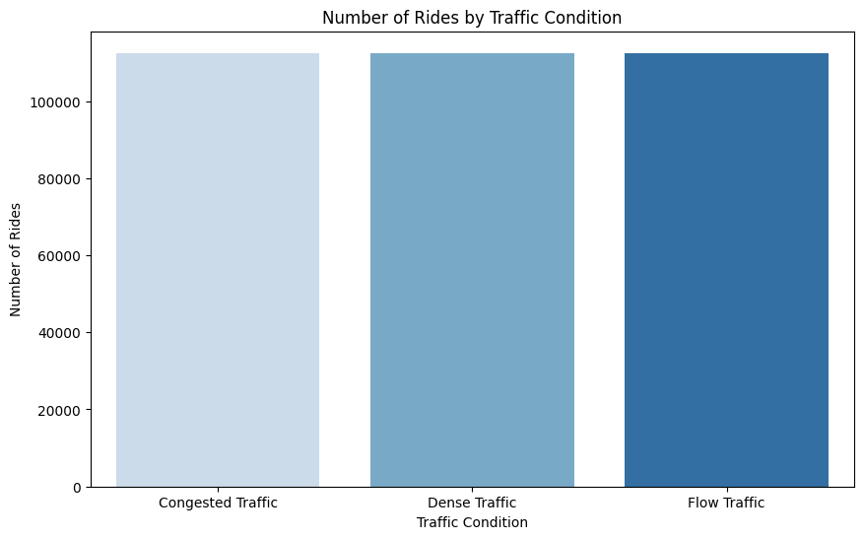
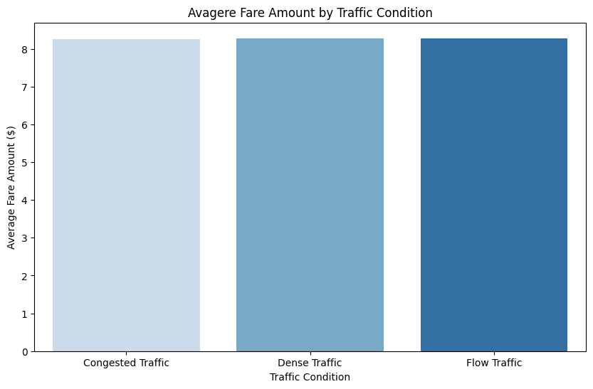
Affect of Traffic Condition

Slide 30
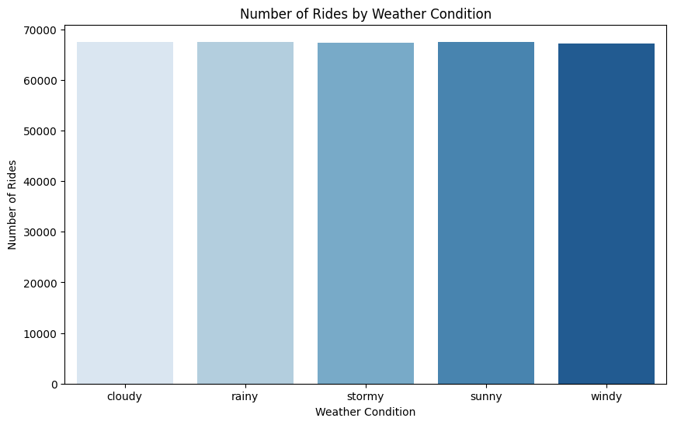
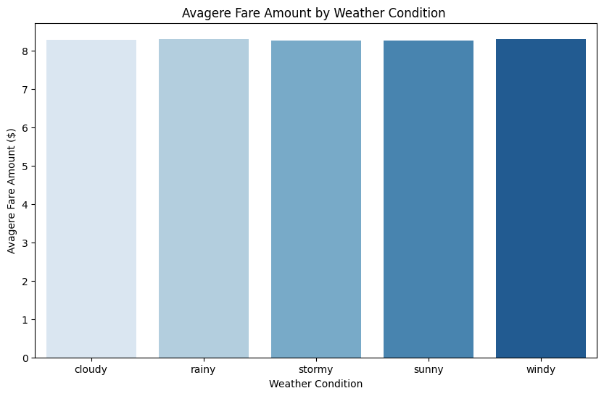
Affect of Weather Condition

Slide 31
04
Conclusion
What did we learn?

Slide 32
What did we learn?
High demands at late night & early morning rides
With a peak from 6:00 PM to 8:00 PM.
Notes:
Number of rides are typically higher during late night and early morning rides, with a noticeable increase in the morning and a peak during the evening. Evenings often see a higher demand for taxis as people finish work, head out for social activities, or return home after dinner.

Slide 33
What did we learn?
We can notice that the fare amount is not affected by weather or car condition

Slide 34
What did we learn?
Low demands in Summer (7, 8, 9).
Notes:
Warmer weather encourages people to walk or bike rather than take a taxi, especially for short distances.
In addition to schools and universities on break, so there is less need for daily commuting to educational institutions, leading to a drop in ride requests from students and staff.

Slide 35
05
Outro
Next steps forward

Slide 36
Outro
As we move forward, the next steps must involve implementing these insights into actionable strategies for taxi companies. In which, will help to refine fare structures, improve service quality, and ultimately provide a better experience for both passengers and drivers.
Thank you for your attention and participation.
Notes:
As we move forward, the next steps must involve implementing these insights into actionable strategies for taxi companies. In which, will help to refine fare structures, improve service quality, and ultimately provide a better experience for both passengers and drivers.
Thank you for your attention and participation.

Slide 37
Thanks!
Do you have any questions?
Team 1 Group 2
Please keep this slide for attribution

